Slide 1

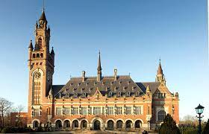
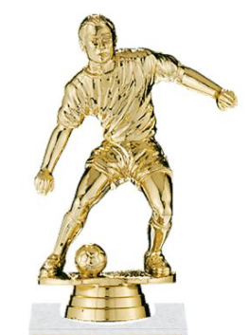

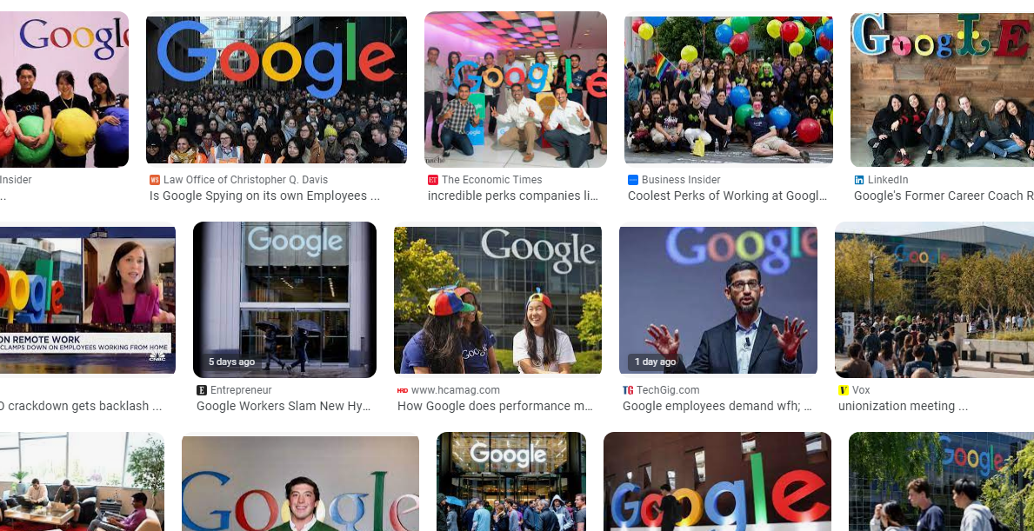
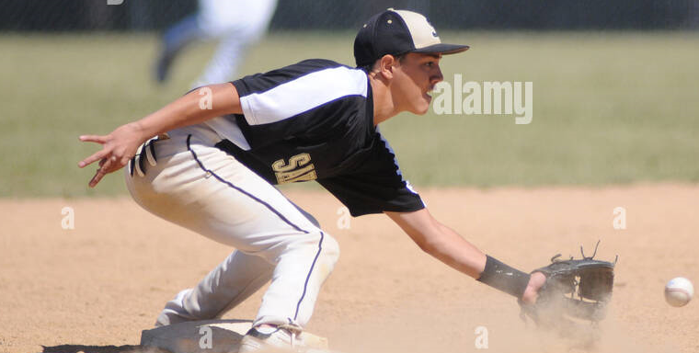
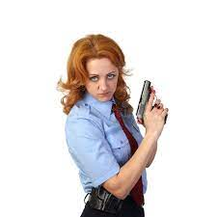
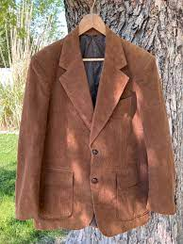
FBI
development
1987
VIRIGINA.MARY
N-E-W-S
Never Eat Screedeed Wheet
Pentogn Base Teache Paul
IPX AYSO Foster City
Trainer Unknown: Baseball Player
Tainer Black catches ball in half-kneiling knelling position
1987 CPVA.ASSHOLE
!HOMICID:CHANLORE
docs
1987 gov mccarty shports coat brown
v2 .HOMISIDE:SUNSTORK (kodak davis w/o phil.JFK.MLK)
PREA
SAINTRITA brown face parent seprated, puned in face
PREA
davison

Slide 2
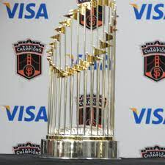
FBI
development
2014

Slide 3
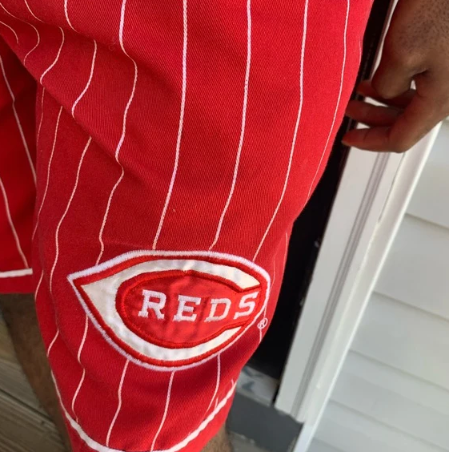
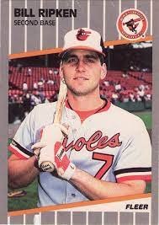
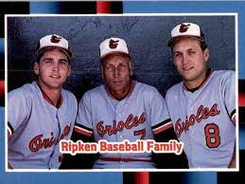
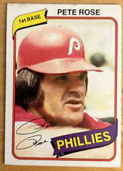
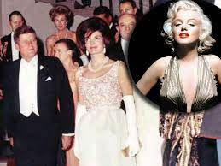
FBI
development
Brown Winter
Ibm-dns:season.com
VIRING:HOMCEI:CHANLORE
(book; ATB male,femal merkel/shcokder,sam/VIRINGAI)
1993
LACE
JANET
1995 Paul, Pentong Militayr Base Neutrate
Bundeskansler Schroeder, germahrd
Roth.lisa.schroder
RED: Ghoeh(Jackson)
Short: 88th Military wore short pants Schroode (ea braun) evaluaed I nsame,
Guy wearing shorts in winter.
FORT MYERS “F-U-C-K”
1st Grade
ATOMBOBM(tim.iwatch.timer)
VIRIGINA.MARY
N-E-W-S
backup
HOMCDIE:NANA(posche)
3’’s a company
CPVA
JFK
Gary fred
Telsa Apple Comptuer
VIRIGNI bay rea news haner
Lias !auntie

Slide 4
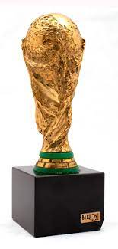
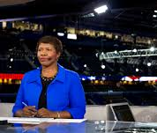
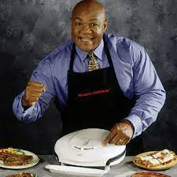
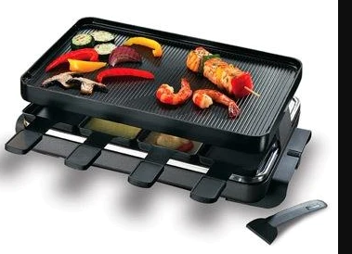
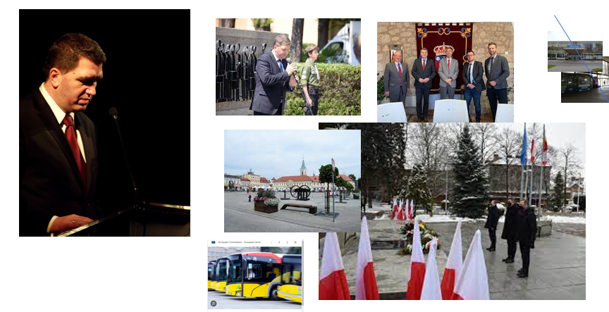
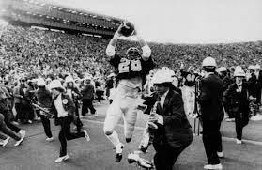
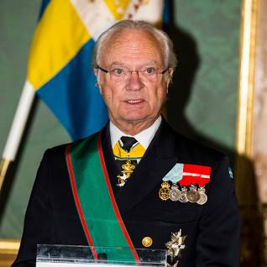
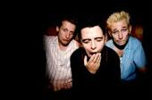
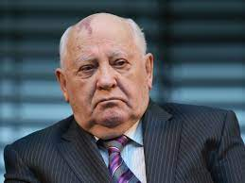
FBI
development
1990
June/July
UC BERKELY
UC DAVIS
MATHEW(sr.1D8723)
STANFORD
Ghhceo(roth,the game)
O
Dartmouth
Pentagon.us(deere,apple.cat)
HOMCIDE:GOOD YEAR.ghcoh(micehala Wife Facotyr worker)

Slide 5

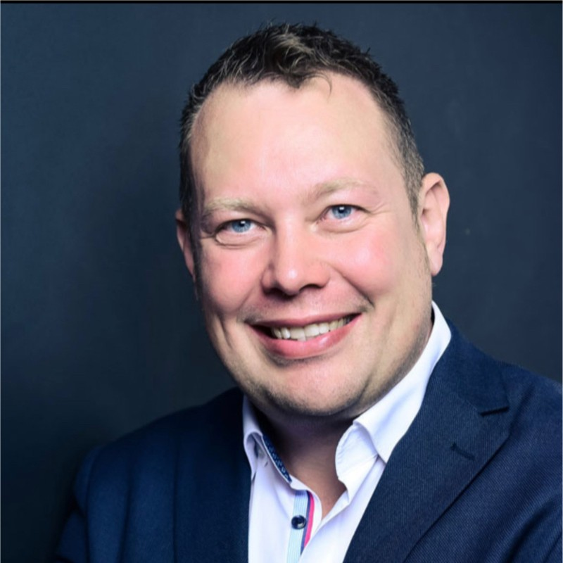
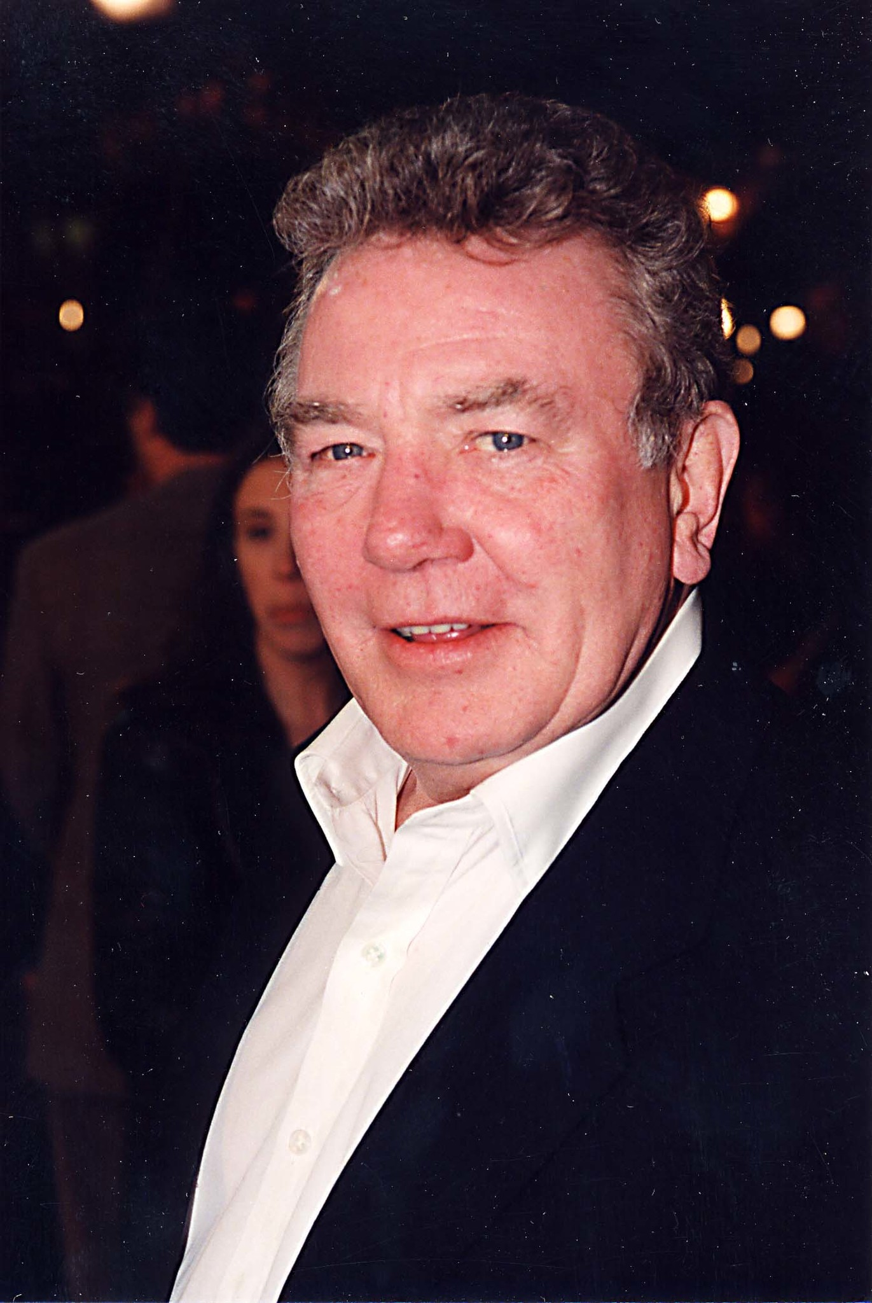
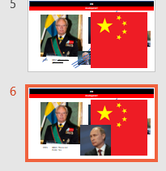
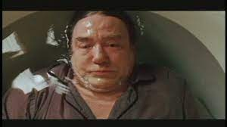

FBI
development
41.IPX.NAVY.(marline 1366, HOCM:LUX:VHS)
PERSISTNANT
1989 KING: This is red
ghheo: Yes

Slide 6
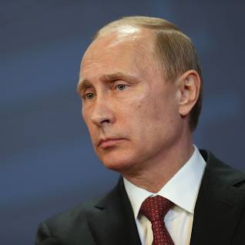
FBI
development
2023 KING: This is red
Putin: Yes

Slide 7
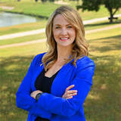
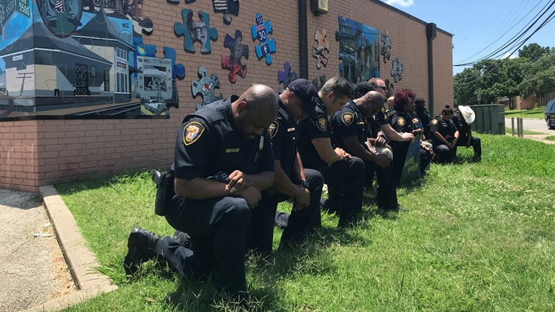
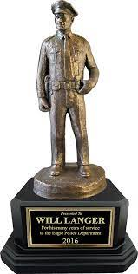
FBI
development
AWARD
Mattie Parker
HOMCIDE:GOOD YEAR.ghcoh(micehala Wife Facotyr worker)

Slide 8
FBI
development
My Wfie is still alive Gorahv is dead, Wife Swdiwh Preisent.

Slide 9
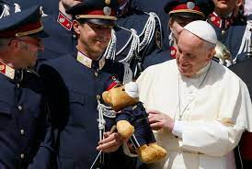
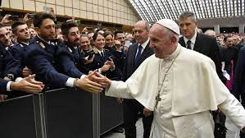
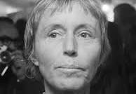

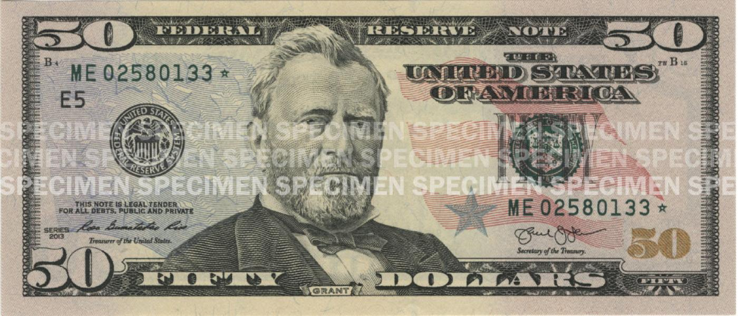

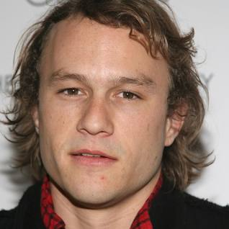
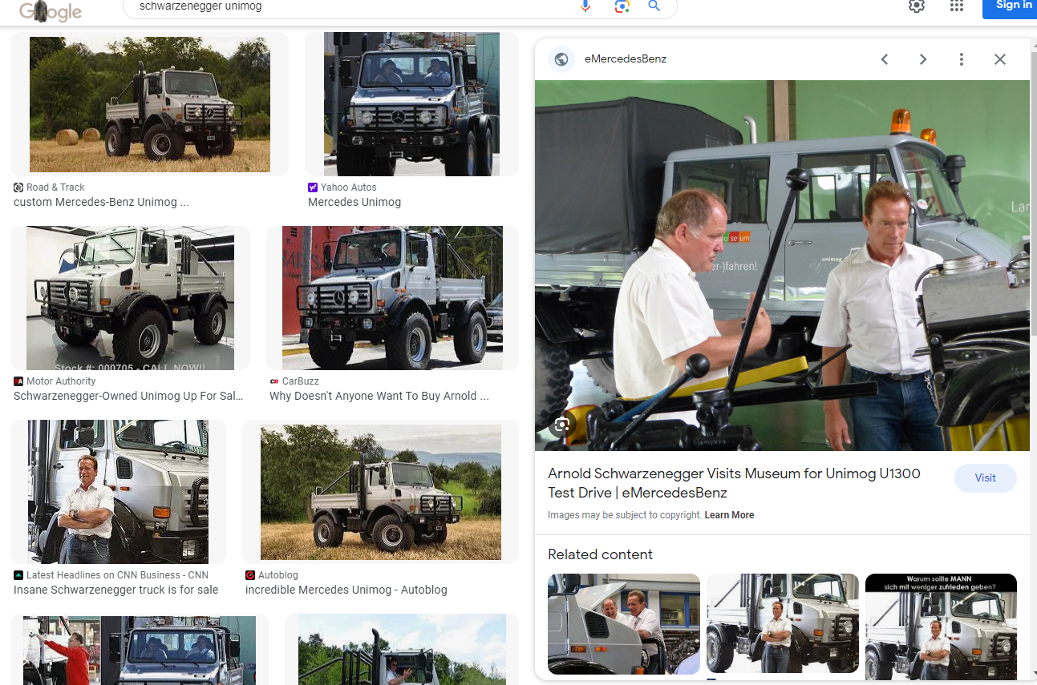
FBI
development
1994 actor dies on set batman
PENGOAN VIRING MARY
1995/6
Dies on set
CHECKPON CHALIE
CPVA(HQ.Petaluma, apple)
Birkeinstock
Franhise
Rene
HOCME:IS-A-Bell
Brikenstock,
CHECKPION CHAILE
Karstad/hertie
Johnny,( frauke,rense sister )
!HOCM:CHANLOR: A.I.D.S.CPVA
wind of change
Picutre eathing ice cream
fat actrees at beach
41.Not there
Phil.JFK.MLK, HOMCEI:NANAE
“mother”
Mtoher: you do that? No.
Ghcheo(dell.client.Beathe)
1995/6 ATB PEOGIN VIRING MARY HOMCE:NANA ( 3’s a company)
MAYR.marx(denise)
Mary.marx(beath)
There not there

Slide 10



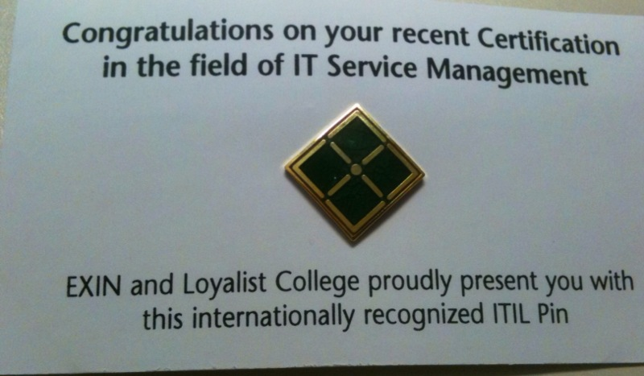


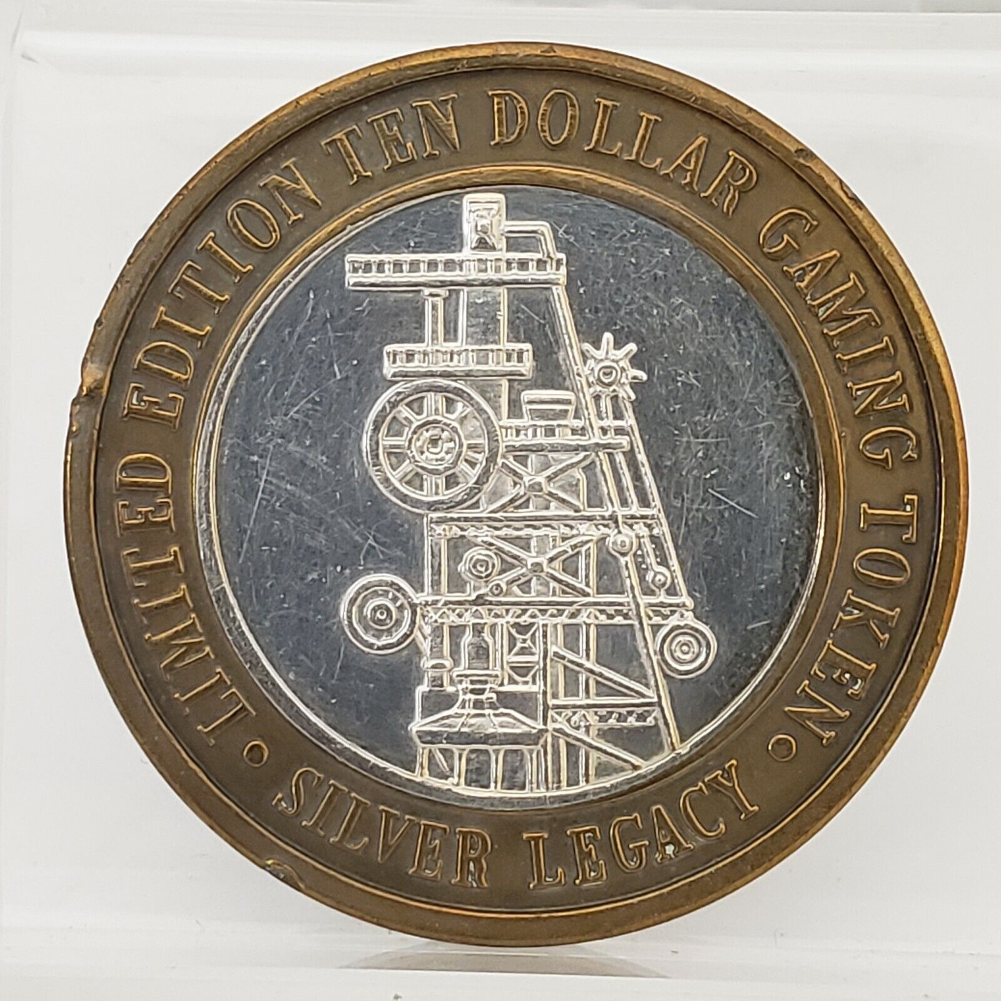

FBI
development
sw-de.marx.sw-us.marx.streetcrimfighting.ddr.sovietunion
sw-de.marx.sw-us.marx.streetcrimfighting.ddr.sovietunion.yugoslavia
itil{
nonPoliceTicketLogial
}
SW-SW
ATM
ATF
BAC
FEDERAL
CPVA.kpmg
sw-de.marx.sw-us.marx.streetcrimfighting.ddr.sovietunion.yugoslavia
!HOCMI:CHANZELOR(anglea)
STANOF:PMP
JSPHESE: tesgin center IBM A.I.D.S MAINSTERET(stant claraa)
PLEASANTON, Califonia
websphere
INT.NAME CHANE(free pizza orgamica)
HOCME: 0.` 9-1-1
reno coins 10
free screws
Stev michela
An employ is a progrestute
VIRGINAI: pwc, KING.arthruh Tivoli consutaitns, IGS

Slide 11
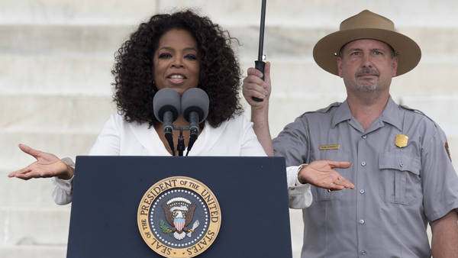
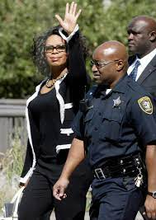
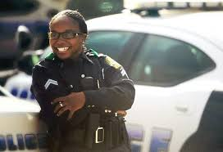
FBI
development
O

Slide 12

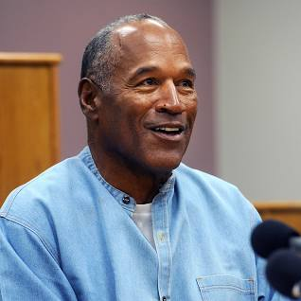
FBI
development
Statue of Libery
!HOMCEI:CHANLOR[]
Spy ircard freinship
Liberay
Short: God does the codinates, astorym
NAMCE CHANE(free pizza)
!you ar her

Slide 13
FBI
development
NOTES:
2023 Paul PoliceCar Keller
1990 nonPoliceKeller(tanl basmetn).PAUL
(roth.HOMCP:LUX(viola and paul, ELKE <s>sex</s>)
1987 phil.JFK.MLK(tophy AYSO)
1st Grade
Basement NAMECHANE(free pizza) Musuems Dirctor(AUSCHWUI(sr. witzerorek)
MATHERWE(sr.1D8723): Sain Rita Prision
Russia.<s>PBS.</s> INTERTNET(web serter)
SQ.</s>marx<s>ghcoeh(<s>2pac,bigge,bad, Melted them towther</s>)</s></s>
!HOMICID:JEUSE:(grhcoheo:Lisa sucidie) x/y SQ.Leathe Injection/ Eletrick CHair</s>
Russi Kreliimin toher 41: ramp skateboard HOCME:IS-A-BELL

Slide 14
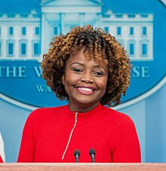
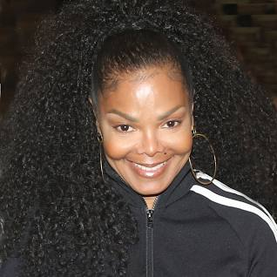
FBI
development
NOTES:

Slide 15
FBI
development
§
1990
PUAL KELLER
VICE PRESNE GEMRANY
nonPoliceKeller
2005 INT.MONPOLY[]
1D8723
2023 Keller (tanls) Basement
Short: Us Citizen has no money is rich.
2 missing. Left country of homelle people

Slide 16
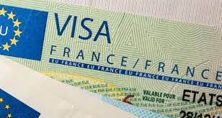
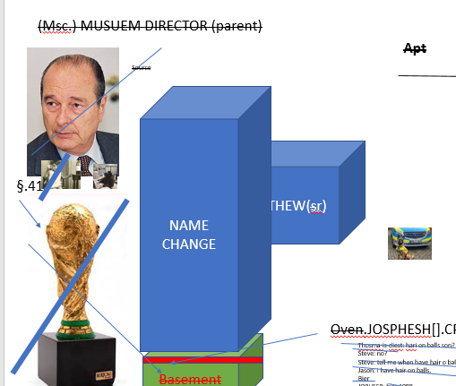
FBI
development
41
MARY
CPVA.AVAIBLITY.MIRCOSOFT
CEHCKPOIN CHALIE(ATOMBOM(hann,MARY celine victory))

Slide 17
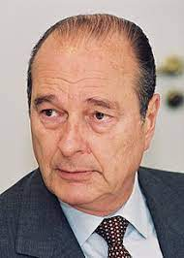
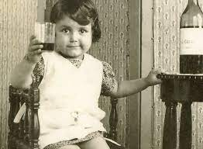
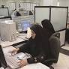
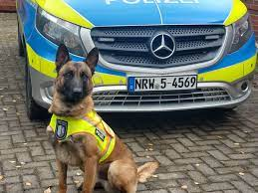
FBI
development
(Msc.) MUSUEM DIRECTOR (parent)
Apt
Source
NAME CHANGE
MATHEW(sr)
§.41
GOD.wine
AUSCHWITZ
!HOCM:BILL.ABIALBITY.CPVA
CPVA. Assuemd: avg (BASELINE).eval.calc(daily,montly,yeliy)
Brings boy HOCME:AUSLSEAR to pizzaria
Oven.JOSPHESH[].CPVA
Basement
Thosma-is-diest: hari on balls son?
Steve: no?
Steve: tell me when have hair o balls
Jason: I have hair on balls,
Bier
JOPHSER: bier 1988
ROTH

Slide 18
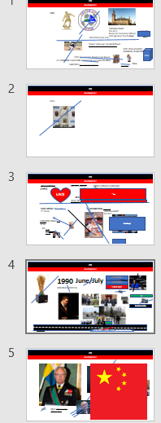
FBI
development
Brings boy !HOCME:AUSLSEAR to pizzaria
eval
1897

Slide 19


FBI
development
!HOCM:BILL.ABIALBITY.CPVA

Slide 20

FBI
development
!HOCM:BILL.ABIALBITY.CPVA
MLK(Performance Evaluations)
!41.1HOMCE:CHANGLROE.nonPoclChart.!AVAIBLITY
2023-1990=35
1980-2023=43Y
HOMICDIE:NANA scrabble, freed gary
CONSTINT:(copy) NAMCHANGE(fre pizza)
B
J

Slide 21








FBI
development
!HOCM:BILL.ABIALBITY.CPVA.VP GERMANY
1988 Elke meets Mattias Vitchrecs Father
MAINSTEET(Roth.MARY.marx(babsi nachecafe singer sex bed matthia and babs))
INT.FBI:KIDNAPPING
000.tw.pns. Lary page and serbary gring

Slide 22





FBI
development
ATOMCLOCK(SQ.CPVA.PREA.§187)
About 34 years
Max-Planck-Instutue
3000 Famly Debt
Dr. Dr. Prof. Joesphe: So and then, Max-Plank
calc
1954 !HOMICIDE:CHANLOR[].aei

Slide 23



FBI
development
41.WWI.”tootsie”.!HOMCEI:KYSTAL
41.Tyson and densie
ATOMCLOCK(SQ.CPVA.PREA.§187)
“2 people missing, live!”
0.1 AVAIBLITY.FBI:WMD: micehaofot.ronsons
https://www.bundestag.de/ips

Slide 24









FBI
INSIDE
development
Roth.gary.!fag.hand: go long
John elway
Super mari unliimte lives Level 3-1 turnkin hope flag
Levoon unlimte touch downs - levon
w/o book Foster city Avg- Elementary
FBI
Stanford
Dr. Rice: call you Blackhawk 1-3 children
george bush sr facebook picture children
CPVA.PREA.HOCM:IS-a-BELL(sovie union)
0.1 CPVA.HOCME:CHANLOR[]
200 children
Stanford
super mario level 3-1
CPVA.SE-SE.GREENSPAN
FEDREAL
BANK
Rdhair full person, kollros: MARIO
CPVA.!HOCME:SJUES:HOMCE:PETER.ghcheo(mcihaala).v2

Slide 25







FBI
development
1991
Ipx.HCOM:NANA
Ghceio(Dr).HOMCEI:MAYOR.Saint Peter
go long
41.!HOMICIE>CHANLOR
Repulican , Branden Burger Tor, Left Front
HOCME:LUX.VIRINGIA
robots
CHINA not Chinese
Polien to make decioins (Left/Right)
nonPCieConteItem
Julian A1 Berline, Warshce PAUL
!MATHEW

Slide 26










FBI
development
41.
https://www.whitehousehistory.org/national-council/eula-adams
Joel Fired Gun – Donique Ablae - Adams
HOCME:LUX.VIRINGIA
CPVA.MARY.VIRIGN hand
VP GERMANY
NAMCEH CHANE
(free pizza gravit, touch apple, apple pay)
DEA(lsd)
x/y Obvilioon
HOMCEI:BILL.ABIALBITY.CHECKPOINT CHALIERE
HOCEMI:LUX(INTERNPO IRAN)
Ghcheo(dr wasadi, apple touch)
AVAIBLIET.187.nonPolceJudement
nonPociVeridct
roth
Rothschild (1744–1812), ...J
Janet PRICE
Black gjy walks into store kill person, is innocient
IPX. PREA aral/anal gasstaion florian
quest software robot replay
CPVA(ATOMCLOCK(time)
ATOMCLOICK(iWatch.erassmus medical center)
LABOR CODE, CIVIL CODE
Compter 4: phone ring
Death Row inmate: tim cook
CDCR

Slide 27
FBI
development
SUMMARY
v2.nonPolciTRX.CPVA.ASSAULT.nonPoliceSexAbuse

